Slide 1
FFR Analysis
Alia Shafi & Han Yi

Slide 2
Goals
How many trials do we need to see FFRs?
Does this vary across tones?
Which electrode is the most promising?
Are there any differences across active/passive?
Are there any learning associated changes?

Slide 3
How many trials needed to visualize FFR?
Electrodes of interest:
HG electrodes: 15, 16, 17, 34, 35
Hippocampus depth: 120 (most robust pitch tracking)
Method:
Selected trials in random order and plotted average of 8, 16, 32, 64, 128 number of trials on spectrogram
Found the minimum trials needed to elicit an FFR
Focused on Male Tones

Slide 10
Minimum trials needed to see pitch tracking (Passive and Active together)
Electrode | T1 | T2 | T3 | T4
15 | 128 | 32 | 8 | 32
16 | 32 | 64 | 8 | 64
17 |  | 128 | 32
34 |  | 128 | 64
35 |  | 32 | 16 | 64
120 | 16 | 64 | 16 | 32
Average: | 58.6 | 76.3 | 25.7 | 48
Electrode 120 or 16 seems to be the most promising
Tone 2 is the best for pitch tracking
Need on average 52 trials to see FFR

Slide 11
Active vs Passive
Blocks
Passive Block 1 (17)
18 Active Blocks
Passive Block 2 (18)
24 Active Blocks
Passive Block 3 (19)
34 Active Blocks
Passive Block 4 (20)

Slide 12
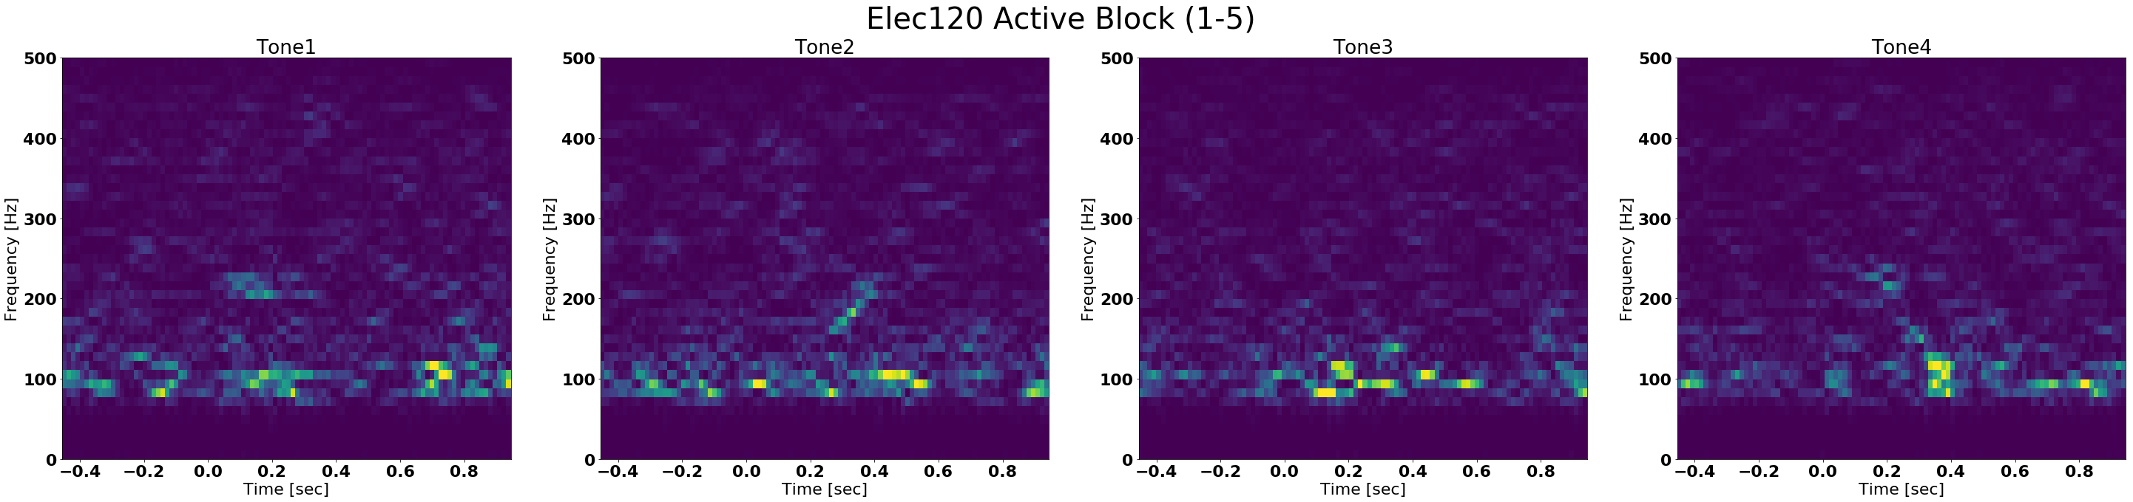
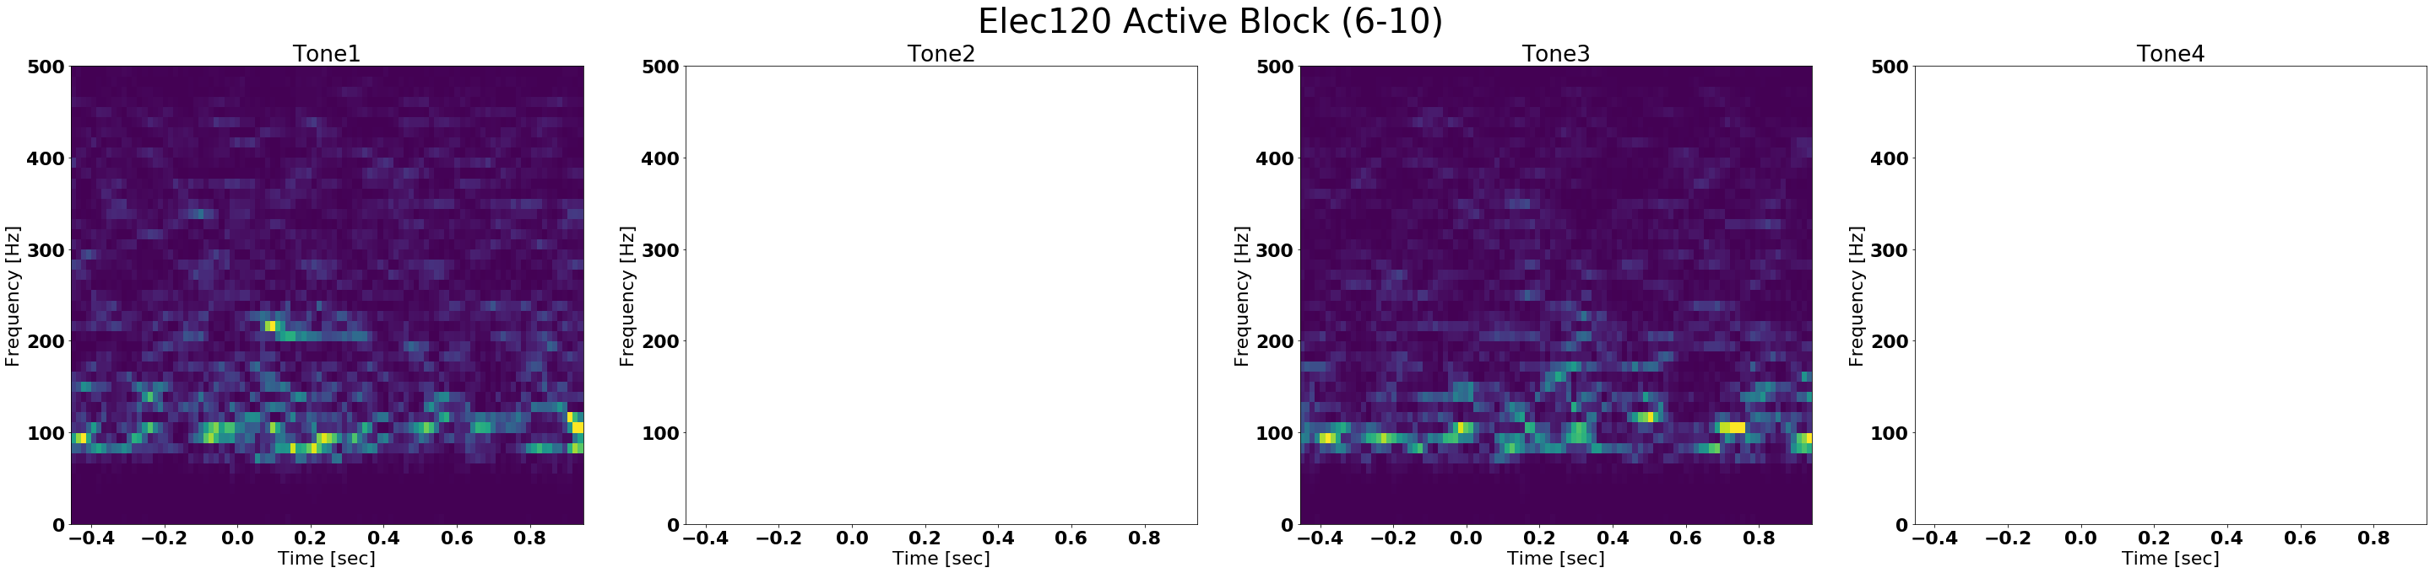
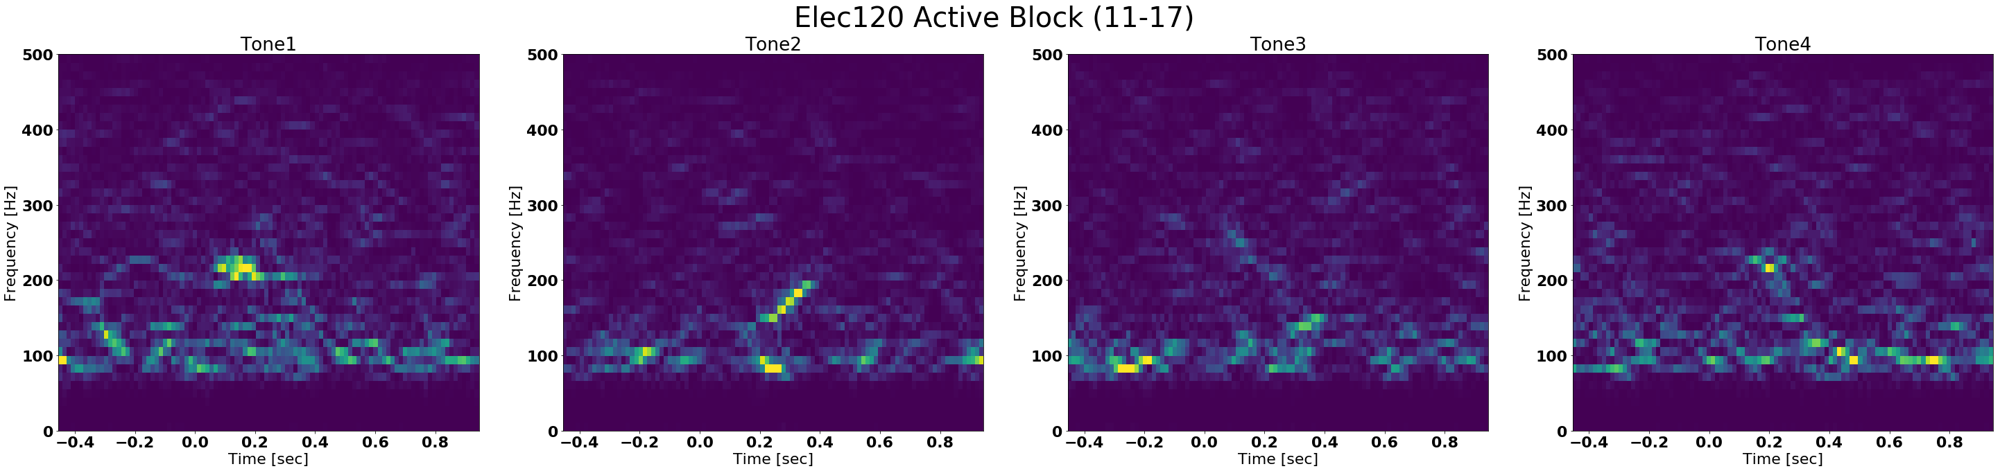
Active Blocks: Male
Notes:
Not sure the order that these blocks went in…

Slide 13
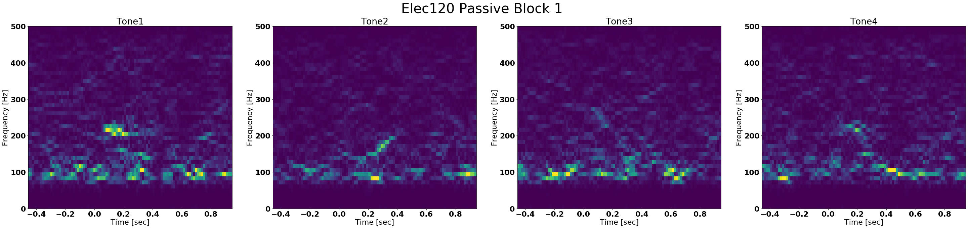
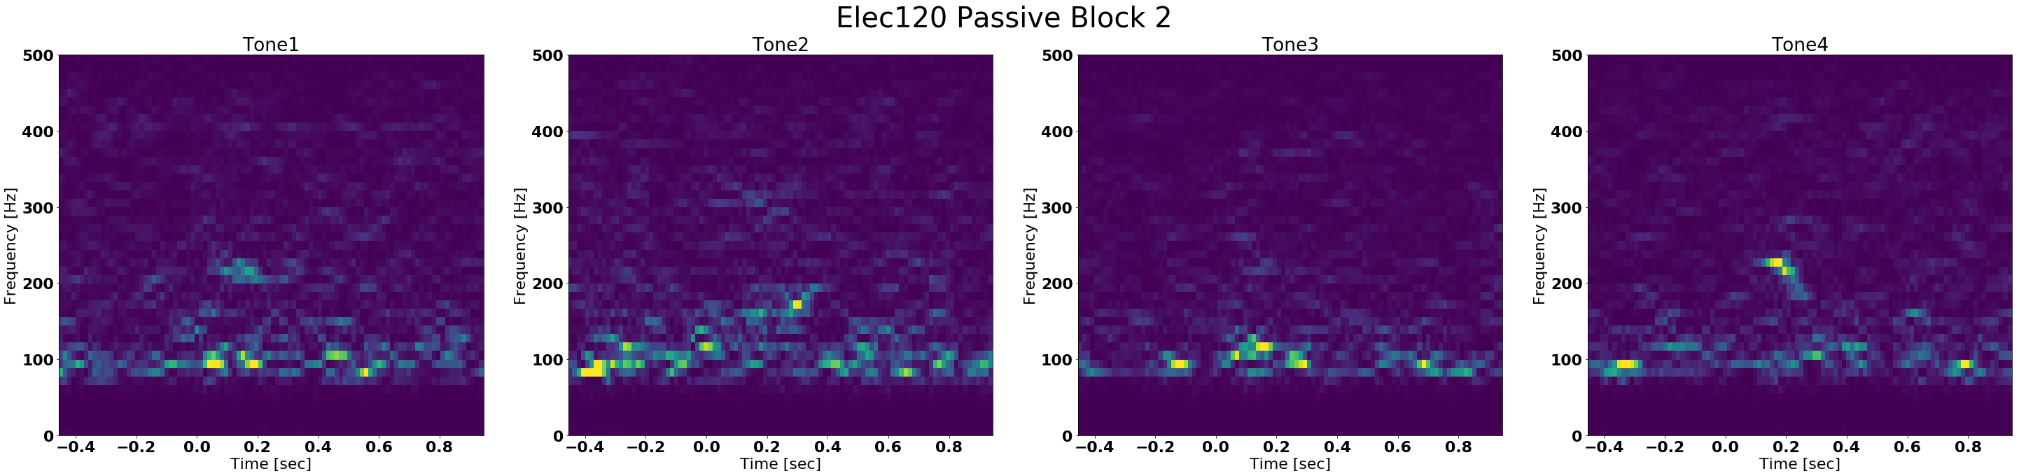
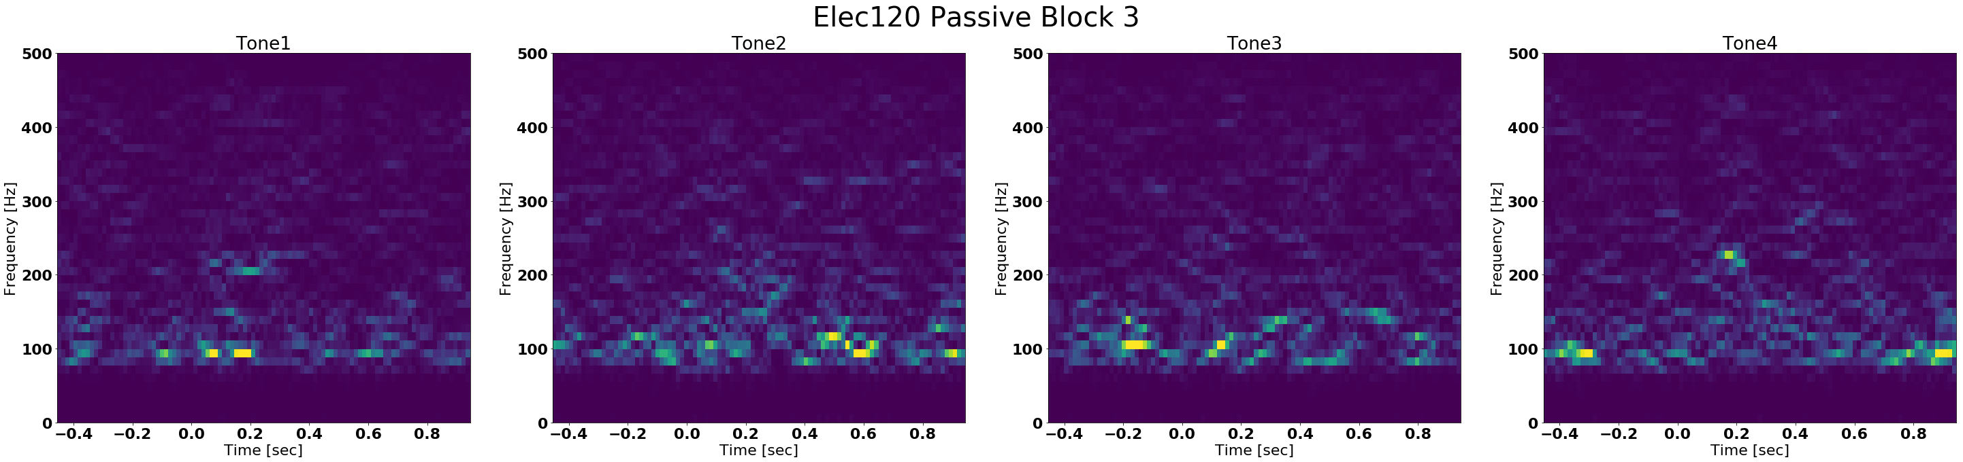
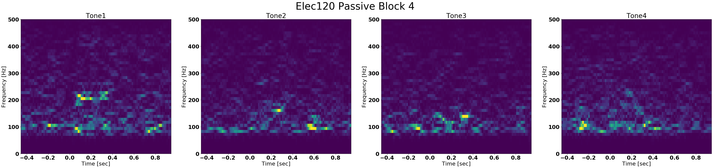
Passive Blocks
All tones have the same number of trials
All male
Electrode 120
Most likely not enough trials to really see FFR

Slide 14
Conclusions
How many trials do we need to see FFRs?
Need about 52 trials to see FFR
Does this vary across tones?
T2 and T3 showed FFR in all elecs of interest
T3 needed the least trials to see FFR
Which electrode is the most promising?
Elec120 sees both male and female FFR, and all tones
But in the HG → elec16 most promising
Are there any differences across active/passive?
Are there any learning associated changes?

